Slide 1

Agri Tourism
by
P. Gousiya
Roll No. 204G1A0534
K. Bramha Teja
Roll No. 204G1A0524
B. Anand
Roll No. 204G1A0511
C. Manoj Reddy
Roll No. 204G1A0554
Under the guidance of
Mrs. G. Nagaleela M.Tech
Assistant Professor
Department of Computer Science and Engineering
Srinivasa Ramanujan Institute of Technology
(Autonomus)
2023 - 2024

Slide 2
Contents
Review-0 Comments
Abstract
Problem statement
Objectives of Project
Literature survey for first objective
Literature survey for second objective
Literature survey for third objective
Proposed System
References
GitHub Link
Queries

Slide 3
Abstract
Now-a-days due to lack of capacity of receiving tourists, viewable product processing and valuable farm commodities, and well-educated practitioner are barriers to effective development of agri-tourism. To improve agricultural wetlands conservation, Sustainable tourism is developed and plays a major part in protecting wetlands, supporting those working in and around wetlands through jobs and increasing incomes.
We are developing an android app to communicate with the farmers .This system will communicate with the farmers to visit their fields and the user will gain the knowledge in crop science.
Keywords:Agri Tourism, Wetlands ,commodities.

Slide 4
Problem Statement
In many regions, there exists a significant disconnect between urban consumers and rural farmers, resulting in a lack of understanding about agricultural practices, limited opportunities for knowledge exchange, and a reduced sense of community engagement.
Farmers often struggle to find a platform to showcase their crops and connect with potential consumers.

Slide 5
Objectives of Project
To create a seamless and efficient platform that facilitates the interaction between users and farmers.
To bridge the gap between urban consumers and rural farmers, promoting agricultural awareness, knowledge exchange, and community engagement.

Slide 6
Literature survey for first objective
Agri-tourism is the latest concept in the Indian tourism industry, which normally occurs on farms. Agri-tourism is a form of agricultural multi-functionality it gives you the opportunity to experience the real alluring and authentic contact with the village life, taste the local veritable food and get familiar with the many farming tasks during the visit. It provides you the welcome break free from the daily busy and hectic life in the peaceful village environment.

Slide 7
Literature survey for second objective
This trend, if recognized by farmers, could be used to create new revenue for agriculture through agri‐tourism. The purpose of this manual is to provide step‐by‐step guidance for farmers who are interested in engaging in agritourism. It presents a number of tools and strategies to design and create memorable farm‐based experiences that can attract and satisfy visitors. The guide also profiles numerous examples of agri‐tourism ventures to encourage innovation within the industry.

Slide 8
Proposed System
The user will register and view farmers crops and the details of farmer and book the slots to spend time with framer by providing the details of the date and number of persons and number of Days. The farmer is going to view that details of the user and the farmer will accept or reject the booking.

Slide 9
References
Singh Priyanka,Mishra Manoj Kumar,IDENTIFYING THE POTENTIAL OF AGRI-TOURISM IN INDIA: OVERRIDING CHALLENGES AND RECOMMEND STRATEGIES [1],2022.
Nicole Vaugeois,Shannon Bence,Anna Romanova , Farm Diversification Through Agri-tourism[3],2021.
Lucian Ionel Cioca; Ramona Giurea; Ioan Achim Moise; Ilaria Precazzini;
Marco Ragazzi; Elena Cristina Rada,Local environmental impact of wood
combustion in agro-tourism structures 2017

Slide 10
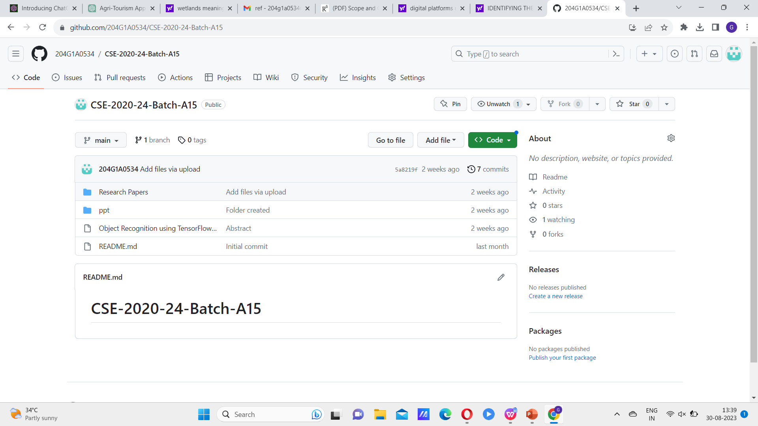
Git Hub Dashboards of each student

Slide 11
Any Queries?

